Slide 1
City of Mishawaka, Indiana
Mishawaka Municipal Sewage Works Comprehensive Rate Plan Summary
November 17, 2025
Baker Tilly Municipal Advisors, LLC is a registered municipal advisor and controlled subsidiary of Baker Tilly Advisory Group, LP. Baker Tilly Advisory Group, LP and Baker Tilly US, LLP, trading as Baker Tilly, operate under an alternative practice structure and are members of the global network of Baker Tilly International Ltd., the members of which are separate and independent legal entities. Baker Tilly US, LLP is a licensed CPA firm and provides assurance services to its clients. Baker Tilly Advisory Group, LP and its subsidiary entities provide tax and consulting services to their clients and are not licensed CPA firms. © 2025 Baker Tilly Advisory Group, LP

Slide 2
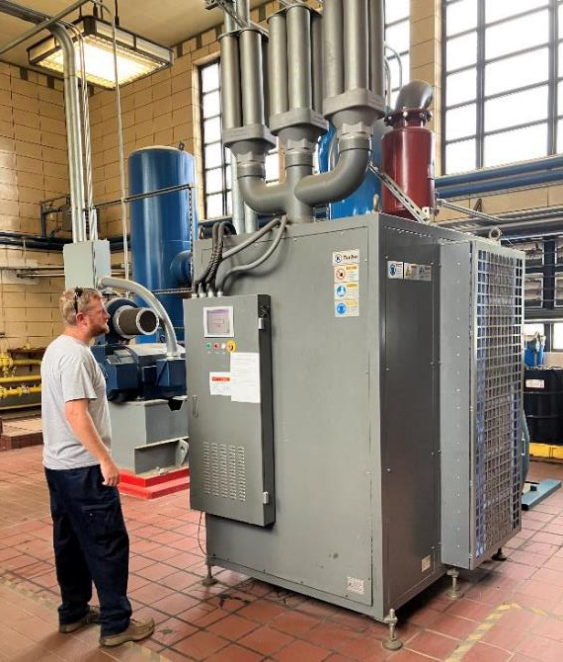
Development of Asset Inventory
Mishawaka (Indiana) Municipal sewage works
Wastewater Plant – Large and complex facility
  1990’s Expansion - $52M in 2025 dollars
  2000’s Expansion - $80M in 2025 dollars
Most comprehensive plan to date / State requirements
Meeting Permit – Lack capacity in certain areas
385 total assets were assessed at the plant
Risk analysis was completed based on criticality
Estimated year of replacement was assigned to each asset based on condition, equipment design life, and criticality
Costs were assigned to each asset

Slide 3
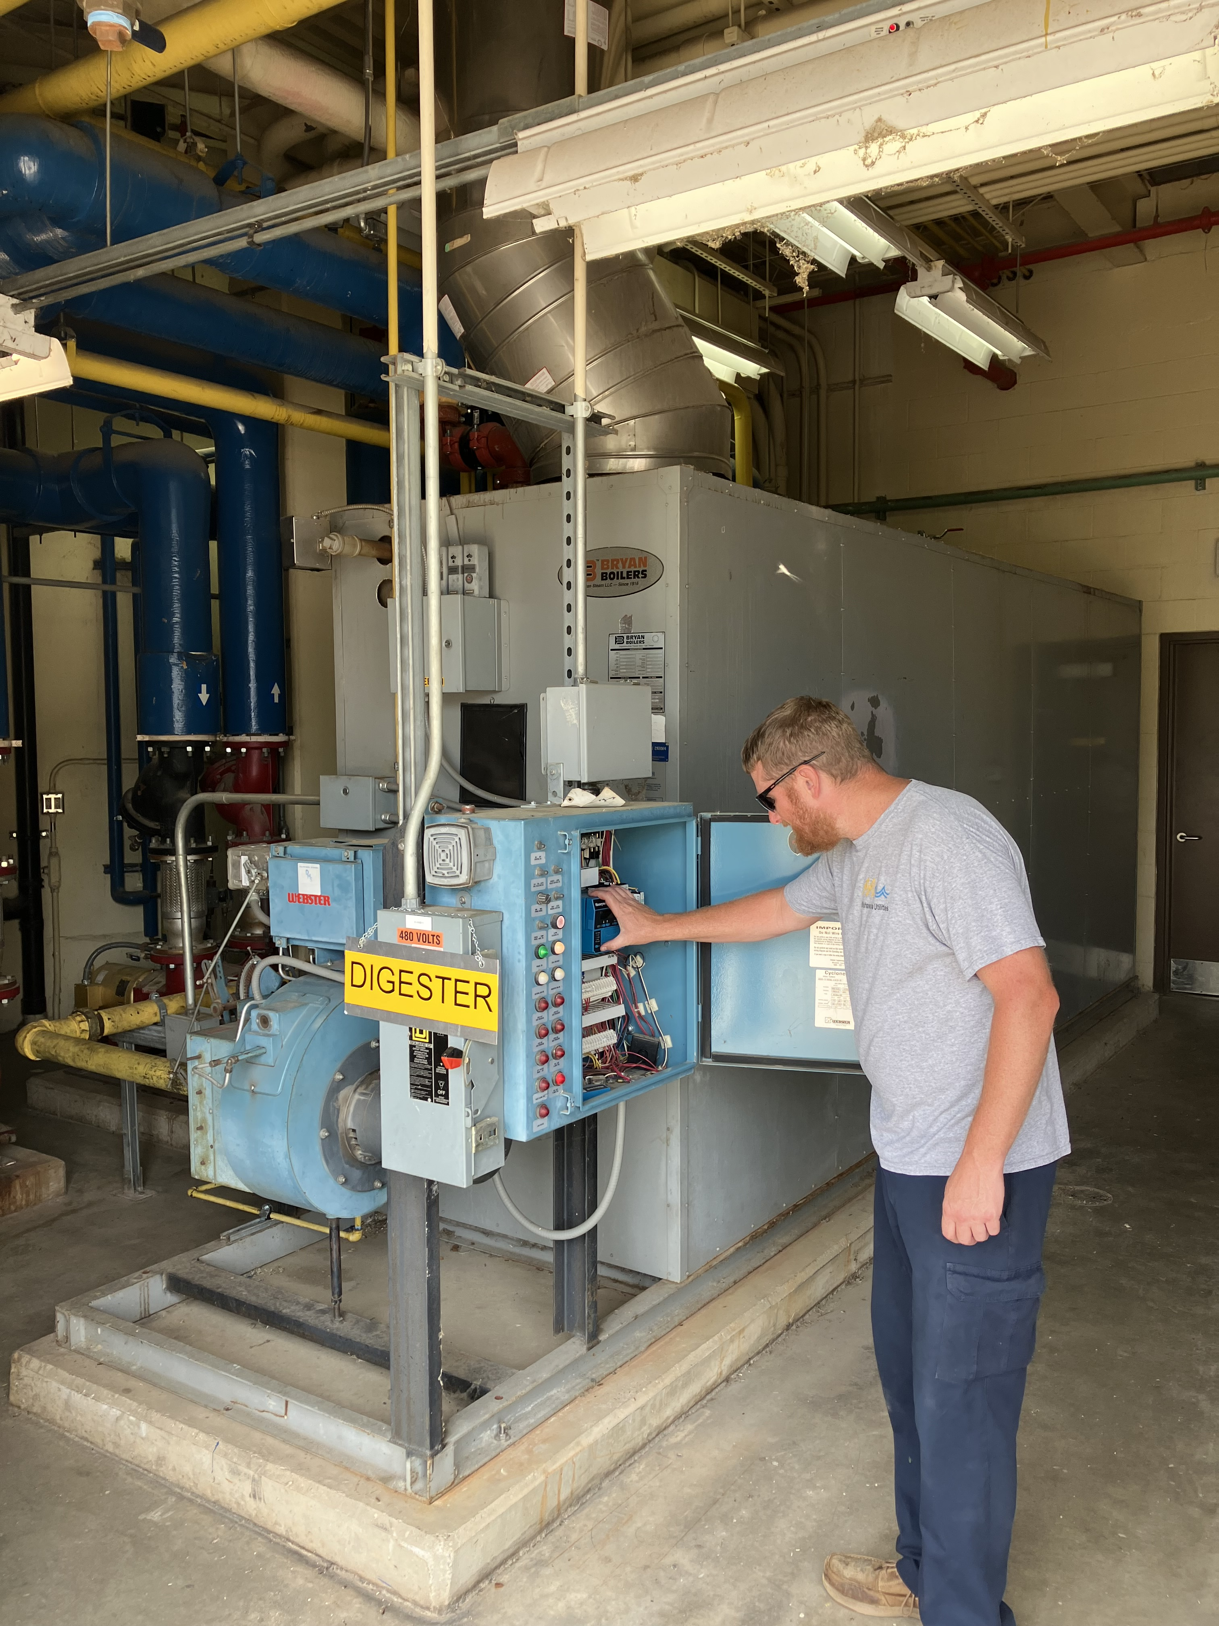
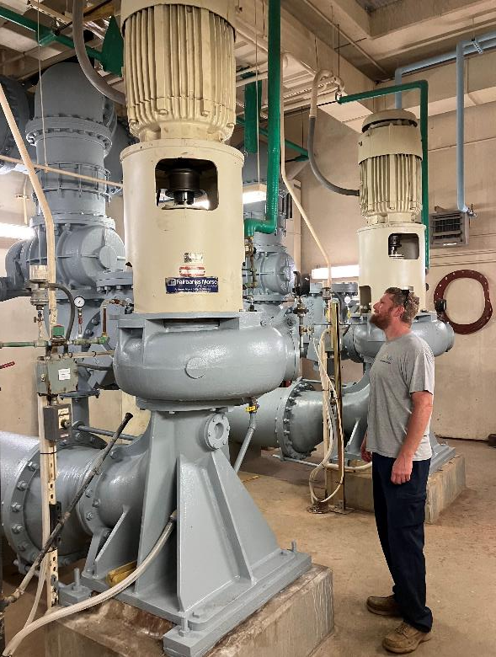
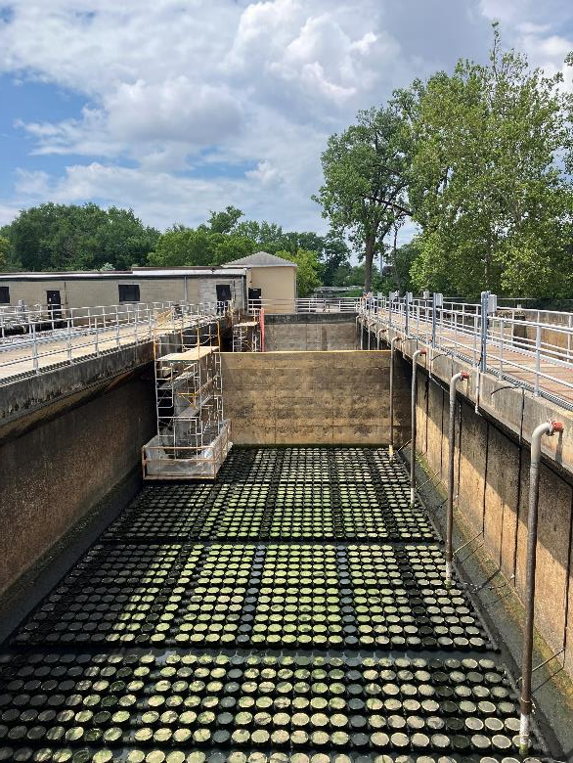
Various Assets
Mishawaka (Indiana) Municipal sewage works

Slide 4
Rate Plan Inputs
Mishawaka (Indiana) Municipal sewage works
Cost Chemical – Increase 60% – 75% since 2020
Improvement Fund
  Examine most expensive unplanned repair to date
  $3.5M Juday Creek Pump Station / Force Main (2005) – equivalent to $6.5M in 2025 dollars
  This was a single event and multiple events can occur
Combined Sewer Overflow Long Term Control Plan (CSO LTCP)
  Unfunded federal mandate – have significantly reduced overflows
  Spent over $300M since 1990 in 2020 dollars
Annual Projects
  Sewer lining and rehabilitation - $1M in 2026
  Sewer upgrades / drainage improvements - $600k in 2026
  Transportation equipment - $50k in 2026 - $750k when Vac Truck replacement is needed

Slide 5
Assessment of Asset Inventory
Mishawaka (Indiana) Municipal sewage works
Developed 20-year plan – Focus on first 5 years
Anticipated Project by Year
2025 | 2026 | 2027 | 2028 | 2029
Lift Station - Harding | Biosolids Upgrade | Scum Concentrator | Blower - Replace Turbo | Electrical Improvements
Blower - Drive Rebuild | Carbon Unit - Headworks | Bisulfite Bulk Storage Tank | Biosolids Asphalt | Ferrous Bulk Storage Tank
Electrical Evaluation | Digester Draft Tubes | Raw Pump Rebuild | Carbon Unit - Central Park | Lift Station - River Pointe
Primary East Rebuild | Electrical Evaluation | Electrical Evaluation | Electrical Evaluation | Lift Station - Rivers Edge
Plant Safety and Security | Grit System - Cyclone Separators | Diffuser Membranes East Replacement | Lift Station - Bittersweet Cove | Lift Station - South Hampton
Biosolids Study | Primary East Rebuild | Headworks Screens 2 & 3 | Lift Station - Schumacher
 | West Primary Tank Limitorque Valves | Digester #2 Mixers
 | West RAS Magmeter & Converters | Biofilter Rehabilitation
 | City Water Tank | Lift Station - Park Place
 | RAS West Control Panels | Lift Station - Lake Shore Estates
 | Biofilter Rehabilitation
 | Lift Station Cell Conversion
Notes:
Speak to LS failure – what happens

Slide 6
Mishawaka (Indiana) Municipal sewage works
Long-Term Control Plan (LTCP) Future Outlook:
Working Toward a Path Forward
Mishawaka Utilities and our legal team at Barnes & Thornburg continue to work diligently to secure a meeting with IDEM, EPA, and DOJ to discuss our LTCP progress and potential modifications to LTCP
We remain cautiously optimistic that this meeting will occur in the coming months, allowing us to demonstrate the measurable progress Mishawaka has made toward CSO reduction and system improvement.
Fiscal Reality and the Need for Council Action
Even with a more favorable agreement, if it would come to pass, Mishawaka Utilities Wastewater (MUWW) must still bond with Council approval, approximately $35 million in identified CSO and Treatment Plant-related projects over the next five years to achieve 2 combined sewer overflows (CSO’s).
These projects are essential to achieving our target of two CSOs per typical year and are dependent on Council approval of the MUWW Rate Plan.
In addition, millions of dollars in critical plant asset replacements and infrastructure upgrades at the MUWW Plant hinge on rate plan approval in 2025 and implementation in 2026.
Why 2025 Matters
Approval of the MUWW Rate Plan in 2025 and initial implementation of the MUWW Rate Plan in 2026 is Vital to the Sustainability of MUWW, operational viability, makes CSO and Plant projects a reality while maintaining schedule, maintains compliance, and preserves Mishawaka’s strong record of environmental stewardship and financial responsibility.

Slide 7
Mishawaka (Indiana) Municipal sewage works
Goal of Comprehensive Rate Plan:
  To develop a short-term (5-years) and long-term rate plan (20-years) that considers all the Utility needs including:
  Operation and Maintenance
  Debt Service – Existing and Proposed
  Roll off of TIF Credit
  Payment in Lieu of Taxes
  Capital Replacements and Extensions
  Long-Term Sustainability
  Manage Impact to Customers

Slide 8
Mishawaka (Indiana) Municipal sewage works
Financial Headwinds
  TIF Credit Roll-Off
    $600k in 2025, $960k in 2028, $900k in 2031 and $900k in 2033. Results in loss of non-utility revenue of nearly $5M between 2024 and 2030
  Capital Projects and Replacements (Heavily driven by the federally mandated $454 M LTCP – Zero Overflow Level of Control (2020 Dollars)
  $291M over 20 years ($14.55M total annually on average)
      $101M in years 2025 – 2030, $190M in 2031 through 2044.
      $121M - Long Term Control Plan (CSO) related – $170M - Normal Capital Replacements (Treatment Plant)
      $223M - Bond funded – $68M - Cash funded ($3.4 M per year)
  High inflationary environment since 2020
  Increases in cost to provide residential sewer insurance program

Slide 9
Mishawaka (Indiana) Municipal sewage works
Key Assumptions
  Provide for frequent (annual) modest rate increase
  Issue Bonds approximately once every three years (7 Bonds in all)
  Rate fund projects - $3.4M/yr.
  Modest customer growth of 1% per year through 2034 and 0.5% 2035-2044
  Maintain cash reserves of no less than $8M within the Capital Improvement Fund
  Replenish the sewer insurance fund to operate in the black and eliminate subsidy

Slide 10
Mishawaka (Indiana) Municipal sewage works
Residential Sewer Insurance Program
  Established to protect Mishawaka property owners from the unexpected and often significant costs of repairing and/or replacing private sewer laterals — the underground pipes that connect individual homes to the City’s main sewer system.
  Failure of lines can lead to repair costs that can vary from several thousand dollars to over $10,000 depending on depth, materials and site conditions.
  Many homeowner insurance policies do not cover the underground pipes.
  Ensures residents are protected from the forementioned devastating costs.
  Aids the City to avoid environmental risks from untreated sewer and groundwater infiltration.
  One time increase in 2026 ensures the financial stability of the program to continue to protect homeowners and the environment from potential significant, unforeseen financial impact

Slide 11
Estimated Annual Expenses - Breakdown
Mishawaka (Indiana) Municipal sewage works

Slide 12
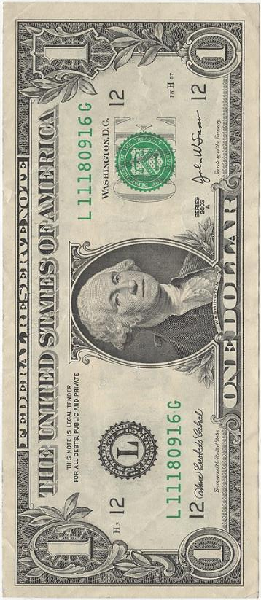
Estimated Expenses - Breakdown
Mishawaka (Indiana) Municipal sewage works
35¢
Operating Expenses
2¢
Insurance Claims and Expenses
46¢
Bond Repayments and Reserve
8¢
Capital Improvements – Cash Funded
Payment in Lieu of Taxes
9¢
Based on Fiscal Year 2026 Estimates

Slide 13
Bill Impact – Proposed PILOT vs Current* PILOT
Mishawaka (Indiana) Municipal sewage works
* Per 2025 Client Budget

Slide 14
Estimated Fund Balances vs Recommended Reserves*
Mishawaka (Indiana) Municipal sewage works
* Excludes construction fund from estimated fund balances and reserve calculations.
** Includes Utility estimate for improvement fund balance need for unforeseen capital and emergency repairs as provided by Utility Management and Consulting Engineers.

Slide 15
Comparison of Historical and Proposed Average Residential Bill
Mishawaka (Indiana) Municipal sewage works

Slide 16
Mishawaka (Indiana) Municipal sewage works
Average Monthly Residential User Impact – 5 Year (Includes Sewer Insurance)
 | 2025 (Current) | 2026 | 2027 | 2028 | 2029 | 2030
Approx. Average Residential Bill (535 CF) (4,000 Gallons) | $60.73 | $63.01 | $65.36 | $67.81 | $70.35 | $72.99
% Change | 0.00% | 3.75% | 3.73% | 3.75% | 3.75% | 3.75%
$ Change | $0.00 | $2.28 | $2.35 | $2.45 | $2.54 | $2.64

Slide 17
COMPARISON OF AVERAGE RESIDENTIAL SEWER BILLS
WITH OTHER INDIANA COMMUNITIES
(4,000 Gal. or 535 CF of flow through a 5/8" Meter)
Mishawaka (Indiana) Municipal sewage works
* Includes insurance fee, South Bend is the only other community that contains this fee in the total bill.
** Long term control plan (CSO) community.

Slide 18
PUBLIC WORKS COMPARISON OF TOTAL UTILITY BILL WITH OTHER INDIANA COMMUNITIES
Mishawaka (Indiana) Municipal sewage works
All of the communities excluding Mishawaka have investor-owned power providers. For communities served by multiple providers, the reported value represents the average for those providers. Included providers are NIPSCO, Indiana Michigan Power, CenterPoint, and Duke Energy.
** Unable to identify a trash rate for the City of Muncie.
*** Includes 2026 sewer rates.

